Slide 1
GP Collective Action
BMA GPC England &
Consultants Committee

Slide 2
Why are GPs taking action?
General practice is in crisis: practices are closing and patients face long waits.
Did you know that 1 in 5 practices have closed since 2010?
Did you know that we have lost over 2,200 fully qualified GPs since 2015?
Funding has not kept up with growing demand
Did you know that we are delivering more and more appointments?
We need YOUR support.

Slide 3
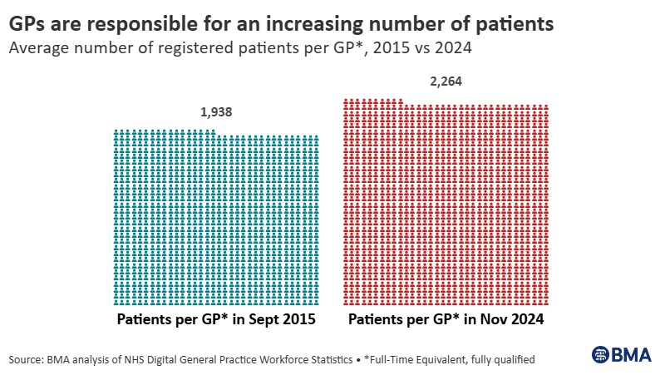
Why are GPs taking action?
We have lost over 2,000 practices since September 2010.
We have also lost over 1,200 GPs since 2015. As a result, each GP is now responsible for an average of 2,264 patients.

Slide 4
Why are GPs taking action?
Approximately 39 million standard (non-Covid-19 vaccination) appointments were delivered in general practice in October 2024, with an average of 1.68 million appointments being delivered per working day.
The average GP practice receives just £112.50 each year per patient for essential (core) services – around 31p per patient per day for unlimited work.
31p

Slide 5
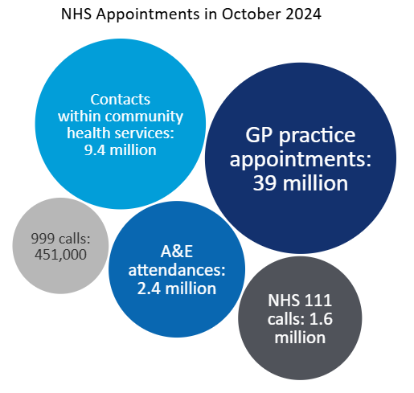
Why are GPs taking action?
GPC England seeks a new contract with additional funding to stabilise practices, employ new GPs, recruit staff, and improve care—without withdrawing services or breaching contracts.
This is a commissioning issue, not a dispute with secondary care.

Slide 6
How could GP collective action impact secondary care services?
GPCE recognises that actions taken by practices could impact those working in hospitals.
Potential impacts may include:
Work redirected to emergency departments and other urgent care settings
Congestion within elective and discharge pathways
Higher referral rates, requiring additional triaging by secondary care doctors
Additional administrative workload for consultants, if letter-based referrals replace proformas.

Slide 7
How can secondary care colleagues support GPs in this action?
GPs may decline to investigate or prescribe due to a lack of a locally commissioned or adequately resourced pathways. GPs don’t want work to be unloaded on you without any allocated time or additional pay.
You and your LNC can pressure the trust board and ICB to commission resources for general practices to do this work, in partnership with the LMC, or for the work to be resourced and included in jobs plans for secondary care colleagues to do.
Ensure clear and timely communication and share essential contact details with GPs after patient consultations.
Refrain from asking general practice to organise investigations and specialist tests.
Offer med3s (fit notes) to all working-age patients upon discharge as medically appropriate, in alignment with hospital contract obligations.

Slide 8
How can secondary care colleagues support GPs in this action?
Communicate any results and follow up care to the patient.
Follow locally agreed prescribing principles on discharge and from outpatients.
Arrange appropriate onward referral, if necessary.
If a GP requests advice, please offer this and if the patient’s needs would be best met by a referral, then please advise accordingly.
Your trust is allocated resources for Advice & Guidance as if it were an outpatient appointment, but GPs don’t get resources for using your advice to prevent outpatient appointments. If you are not receiving job planned time for responding to GP requests for advice or guidance, you can raise this in job planning negotiations and with your LNC.
Inform the ICB and LMC if pathways need to be reviewed to ensure sufficient outpatient capacity; GPs may be able to help.

Slide 9
We appreciate your support, particularly as we anticipate heightened demands during the winter season.
We will aim to liaise with LNCs within your trusts to ensure that, as doctors, we stand UNITED and not divided by ICB/trust management.

